Slide 1
How Tencent WeChat Applies Pulsar's Tiered Storage Adoption, Optimization Experience and Future
YingQun Zhong
2023.10.14
Notes:
大家好
我今天分享的主题是
Pulsar 分层存储在微信业务的落地实践

Slide 2

Self Intro
YingQun Zhong (钟颖群)
Software Engineer – Working in Tencent WeChat big data team
Apache Pulsar Contributor
GitHub ID：@ethqunzhong
Email：zyqbit@outlook.com
Fascinated about big data technology, message queue etc.
Notes:
首先，先做个自我介绍
我叫 钟颖群
来自微信大数据团队，主要负责数据接入平台和消息队列服务的开发和维护
也是Pulsar的 contributor

Slide 3
Agenda
Why Pulsar
Pulsar Tiered-Storage in WeChat
Future Tasks
Notes:
今天的分享将从以下三个方面展开

Slide 4

Why Pulsar
1
Architecture
Application layer
producer
consumer
Application layer
Support multi-language client
Support multi big data frameworks
Stateless logic layer
broker 1
broker 2
broker 3
topic
topic
topic
Stateless logic layer
Stateless broker
Cloud Native
Streaming scenario
Storage layer
LedgerId
ledger x
ledger 2
ledger 3
ledger 4
ledger y
entry 1
entry 2
entry x
ledger 2
ledger 3
ledger 4
ledger 5
ledger 6
message1
message2
messagex
ledger 1
ledger 2
ledger 3
ledger 4
ledger 5
ledger a
ledger 1
ledger 2
ledger 3
ledger 4
Storage layer
MessageId
Striped writing
Isolation
Batch processing scenarios
LedgerId
EntryId
PartIndex
BatchIndex
ledger n
ledger m
ledger x
ledger y
ledger z
Bookie 1
Bookie 2
Bookie 3
Bookie x
Bookie y
Notes:
首先来看下我们为什么选择Pulsar
我们接触大规模使用Pulsar 有两年多时间了，最初选型pulsar是因为我们需要一个消息队列系统来满足业务需求。公司内部其实也有其他的消息队列可用，我们也仔细考虑过kafka，但我们最终还是选择了pulsar。但是 kafka 在如实时训练等场景下使用有限制，且后期运维成本高，最终我们还是选择了 Pulsar
这个是 Pulsar 的整体架构，我从架构层面来讲述下我们为什么选型 Pulsar
1、首先是应用层
多语言Client是我们比较看中的能力。
微信的后台技术栈是C/C++，如果接入的话需要能够支持 C/C++ client。
在推荐场景下我们也基本离不开tensorflow，而tensorflow广泛的应用在python语言环境下，所以python client也一定得有。
另外，通过 pulsar io能力能够很方便的和各类计算引擎对接
2、 接下来是无状态逻辑层 broker
因为 broker 是无状态的且支持云原生方式部署，在实际业务场景下，我们可以快速扩容并且结合负载均衡策略能够很好的应对业务流量突增，非常适合在流式场景下使用
3、 再来看存储层
存储层 BookKeeper 作为 Apache Pulsar 的底层存储
Ta的节点之间是互相对等，条带化的写入方式自带多副本容灾，使系统具备高可用
同时和 broker 一样也支持资源隔离，能很好的避免业务之间的干扰，
Bookie 数据顺序 append 的方式存储数据，bookkeeper也为系统很低的读写时延
所以综合下来，我们最终选型pulsar。

Slide 5










Why Pulsar
1
How we use
ODS
ODS
DWD
DWS
ADS
FeatureKV
agent
SDK
Data collection
Feature library
Model library
Pulsar
Pulsar
Strategy library
Online REC
Hbase
Redis
KV
A/B test
BI analysis
Pulsar
Pulsar
security
Hourly push
Offline import
Online import
Notes:
下面介绍下我们 Pulsar 服务的业务场景
业务数据例如日志、打点、消息等通过数据接入层连接 pulsar 集群，各个上下游系统通过 pulsar 链接在一起形成不同的数据链路，Pulsar 目前广泛应用在训练推荐、实时数仓、离线分析等各类场景中
Pulsar为分布式架构场景提供了应用解耦、冗余存储、削峰填谷、异步通信、数据同步等能力
在业务链路中承担数据总线的作用。

Slide 6
Agenda
Why Pulsar
Pulsar Tiered-Storage in WeChat
Future Tasks

Slide 7

Tiered-Storage in WeChat
2
background
10 min
90% call
9% call
1% call
2 h
2h >
Time Series Data
consume
Use cases | Message lifecycle | Proportion
Real-Time Data Processing | 10min < | 1%
Catch-Up-Reads/Batch Processing | 2h < | 9%
Data Replay/Data Backup | 2h > | 90%

Slide 8
Tiered-Storage in WeChat
2
Why we need
Pulsar as a reservoir
The business side has requirements for the duration of data retention, and at the same time, there is a large volume of business data.
Pulsar as a key node
When downstream business tasks encounter anomalies, we need Pulsar to be able to tolerate long-term data backlog. Once the downstream tasks recover, Pulsar should be able to resume data consumption.
Expensive storage
Data retention for long time in production environment is expensive, with both the Bookie Journal and Ledger disks utilizing SSDs.
Pulsar as a recorder
In scenarios where functions like data reconciliation are required, we need to backtrack and process the historical data that has already been consumed.

Slide 9


Tiered-Storage in WeChat
2
Offload framework
producer
consumer
Hot data
Hot data -> broker -> memory
broker 1
broker 2
broker 3
topic
topic
topic
Warm data
Warm data -> bookie -> disk
Time Series Data
Cold data
Cold data -> offload -> tiered-storage

Slide 10
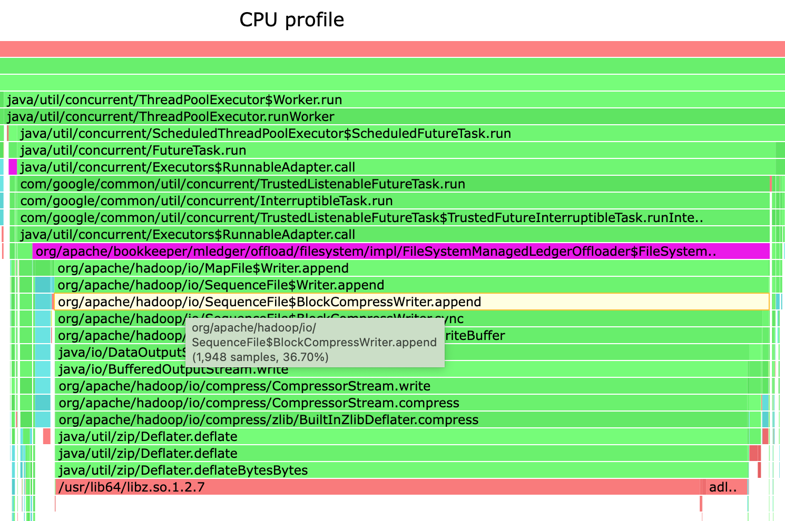
Tiered-Storage in WeChat
2
Optimization Experience: Offload Performance improvement
optimization
1. Write performance of a single partition has increased 5x+.
2. In the cluster stress test, the offload write traffic reached xxG/s.
Problem
Offload write speed is slower than the incoming traffic of the topic which may cause data lost.
What we do
1. Set Compression Type with NONE. (for filesystem)
2. Parallelization of ledger offload.

Slide 11
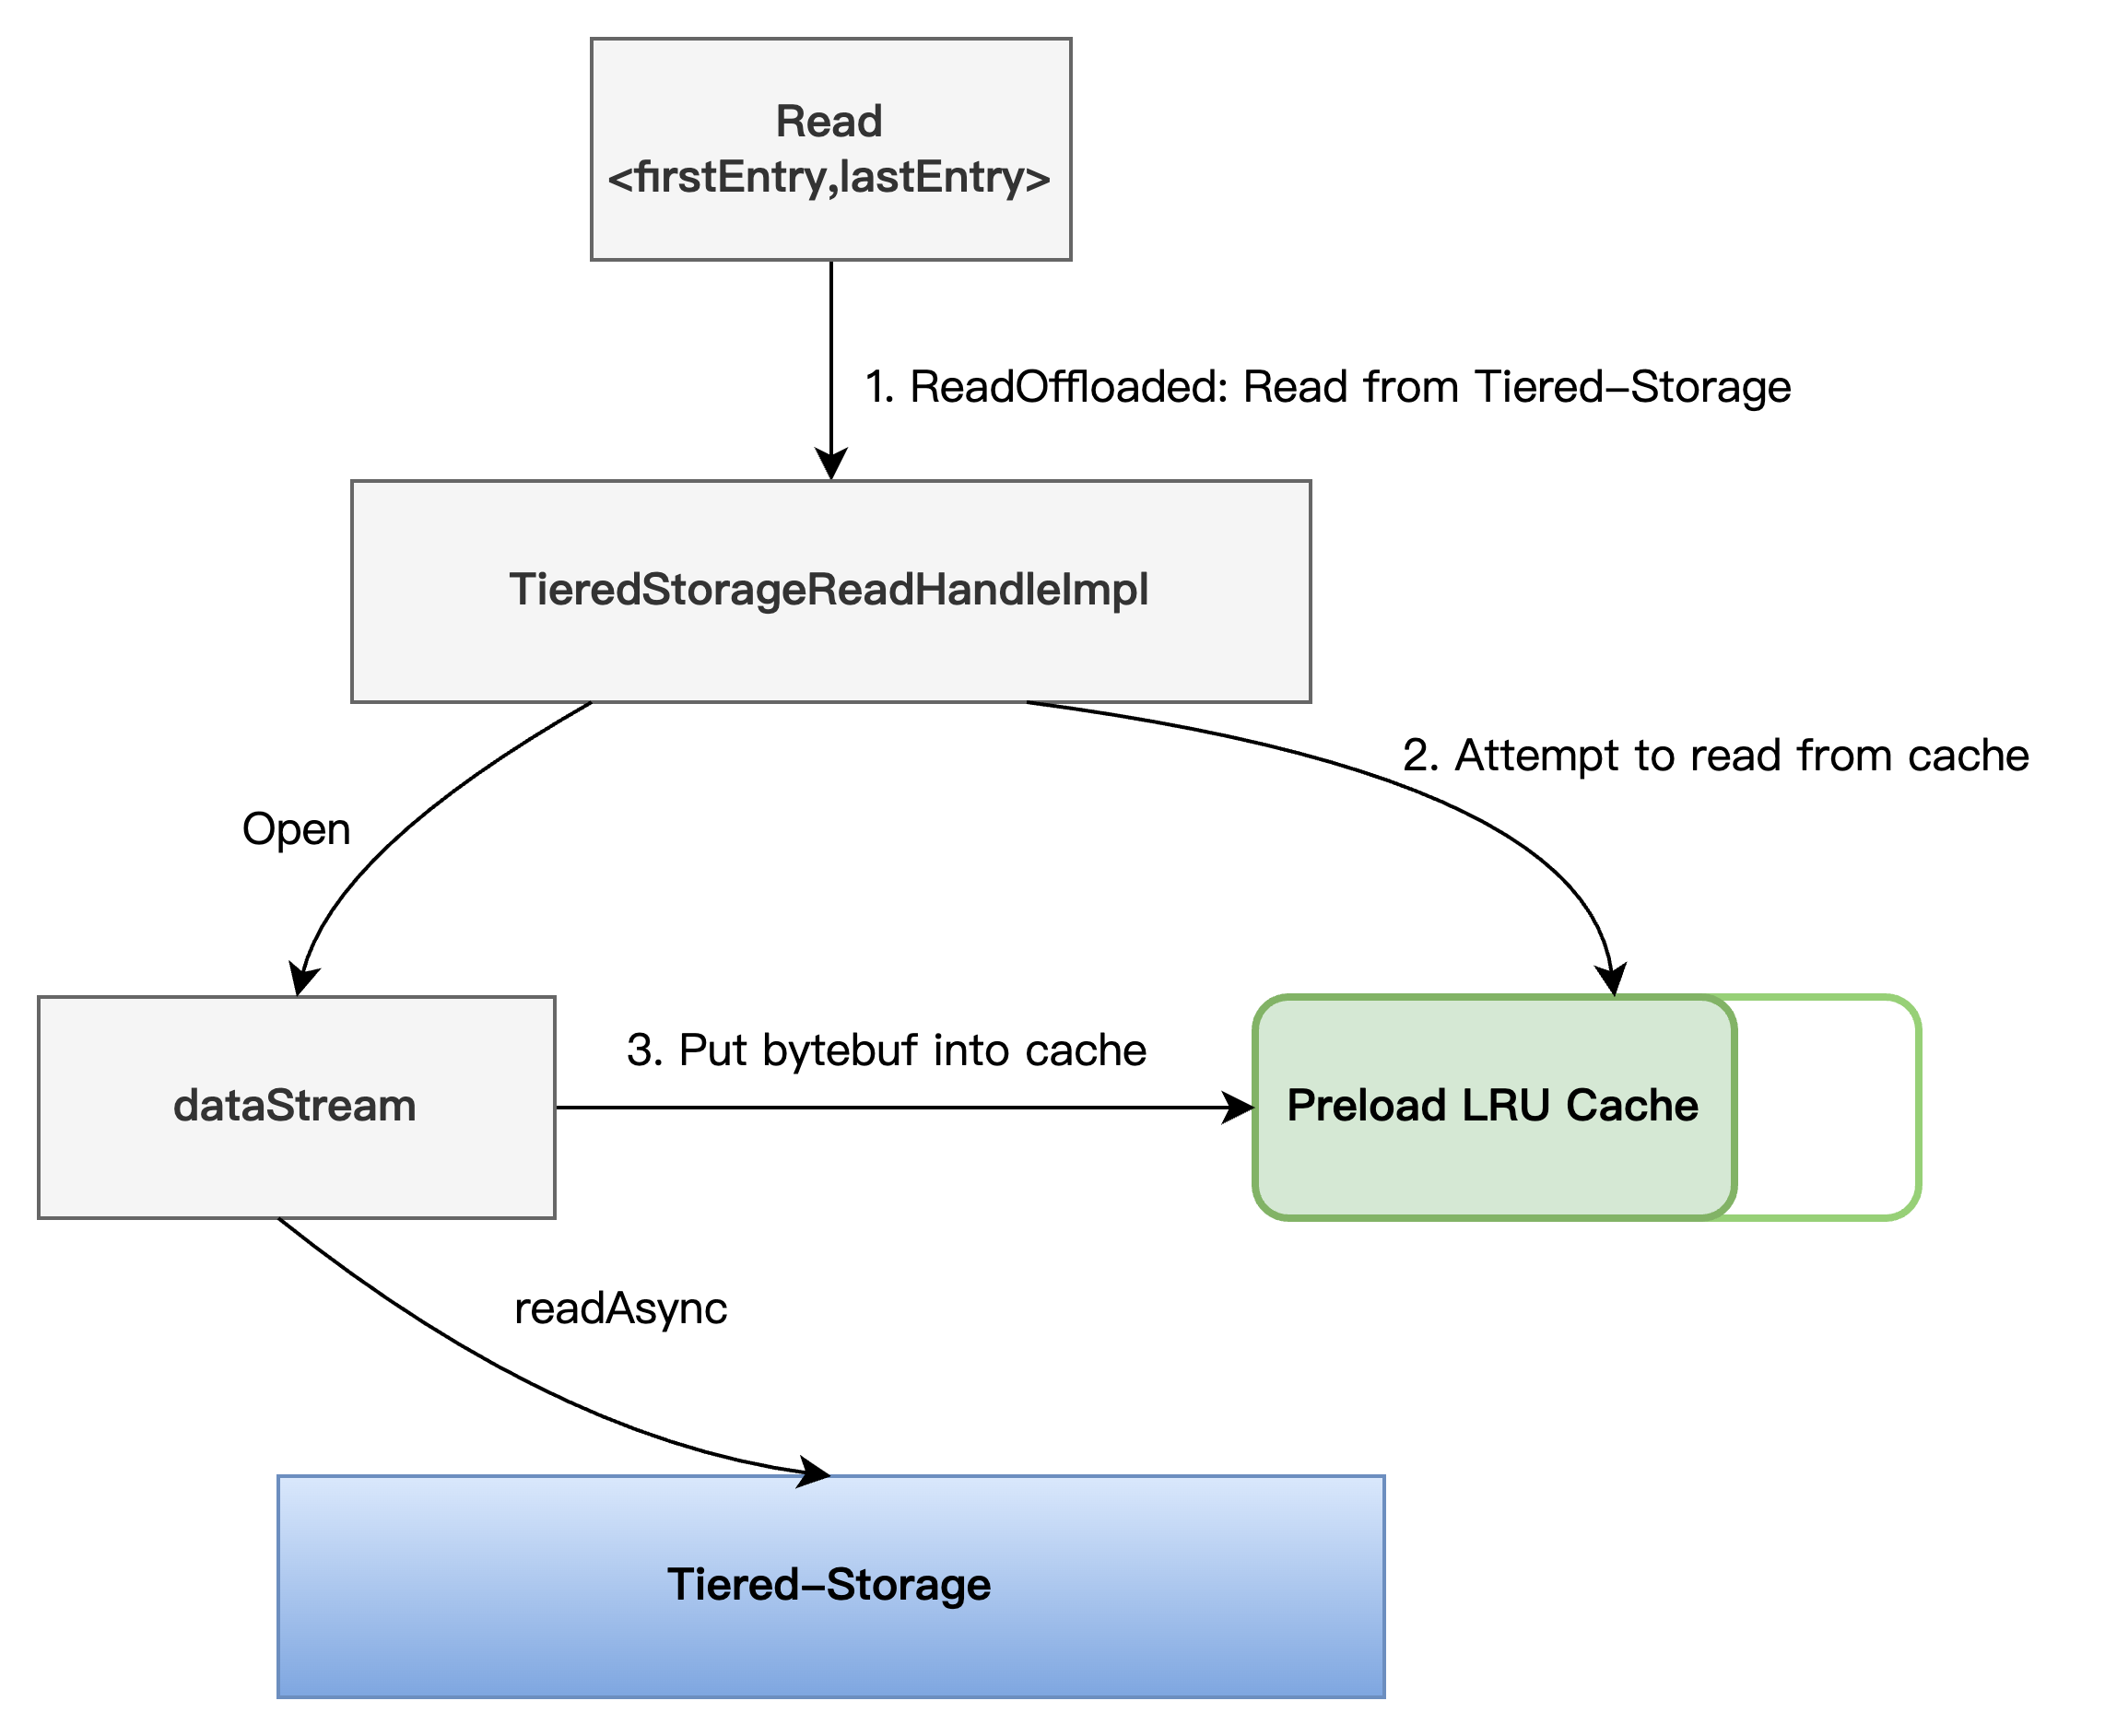
Tiered-Storage in WeChat
2
Optimization Experience: ReadOffload Performance improvement
optimization
The read performance of a single partition has been increased to about 75% of the bookie's read performance, from 10MB/s.
Minimize the number of seek calls.
Problem
Slow reading speed leads to lagging consumption data, and even loss of data reading.
What we do
Add read LRU cache.
Preloading.

Slide 12
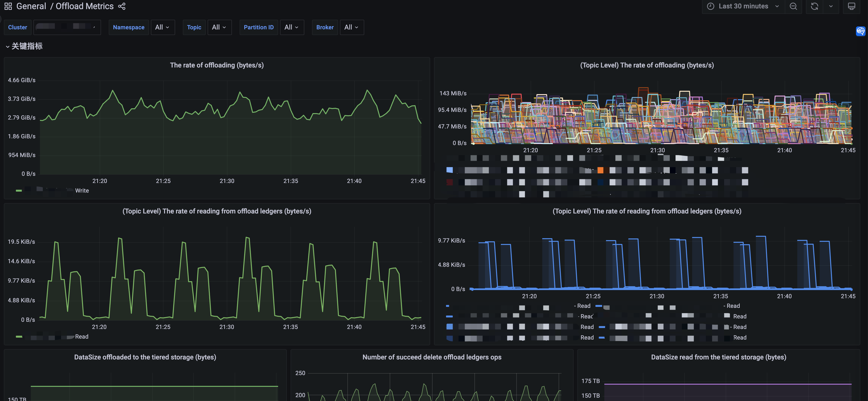
Tiered-Storage in WeChat
2
Optimization Experience: metrics
Offload latency metrics
Offload write speed is slower than the incoming traffic of the topic which may cause data lost.
Main indicators
ReadOffload cache metrics
Pay attention to the time spent on seeking and the cache hit situation.
Write/read latency
Pay attention to the latency of reading bk and writing tiered-storage.
Failed Ops
Timely detection of read, write, and delete anomalies.

Slide 13
Tiered-Storage in WeChat
2
Optimization Experience: Stability improvement
Independent thread to prevent timeout
Add offload scheduler in hdfs offloader in case origin scheduler be stuck for a long time.
bugfix
Filesystem offloader close exception in branch 2.10.x
Offload metrics error fix
make managedLedgerOffloadedReadPriority compatible with broker property
Graceful update offload policy
Reduce interruptions caused by unnecessary recreation of offloader instances when adjusting the offload policy.
More Practical experience
Gradually decrease and adjust the offload threshold slowly.
Pay attention to adjusting the TTL, retention time, backlog, and other parameters such as data retention duration in bk.
Offload enabled may cost more CPU.
…
Flexible configuration of offload thread parameters
add managedLedgerOffloadPrefetchRounds & managedLedgerAssignmentOffloadThreads adjustment.

Slide 14
Tiered-Storage in WeChat
2
use case
Kind of Tiered-Storage
COS (Tencent Cloud Object Storage)
HDFS
Scenario
OLAP ( ClickHouse, StarRocks…)
Import Lakehouse for BI
Business disaster recovery
…
Summary
Significantly reduce costs of data storage.
The stability of the business operations, which utilize Pulsar as a data bus, has been enhanced.
Pulsar possesses the capability for infinite storage.

Slide 15
Agenda
Why Pulsar
Pulsar Tiered-Storage in WeChat
Future Tasks

Slide 16

Future Tasks
3
Connect to lakehouse
Lakehouse：
Integrate and iterate data in a streaming manner.
Unified flow batch integrated storage base.
SDK
Data forward
Pulsar
Use way：
Implement forwarding to the lakehouse through intermediate calculation scheduling layer.
User-defined operators have a certain development and learning cost.
real-time
offline
Flink
Spark
Lakehouse layer

Slide 17
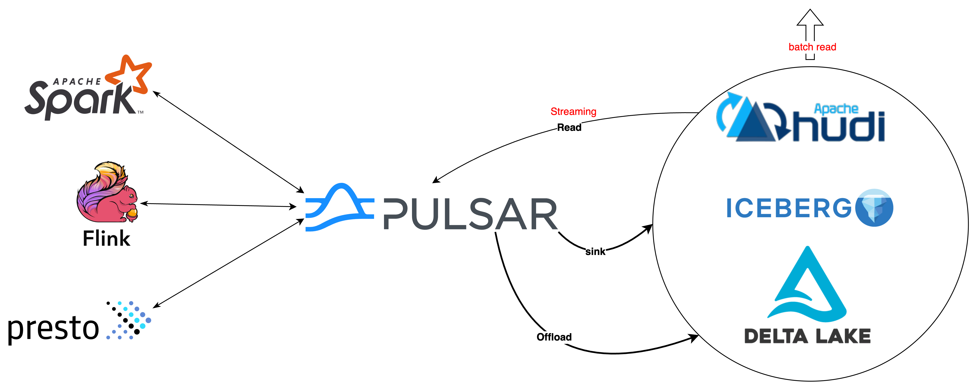
Future Tasks
3
Streaming Lakehouse

Slide 18
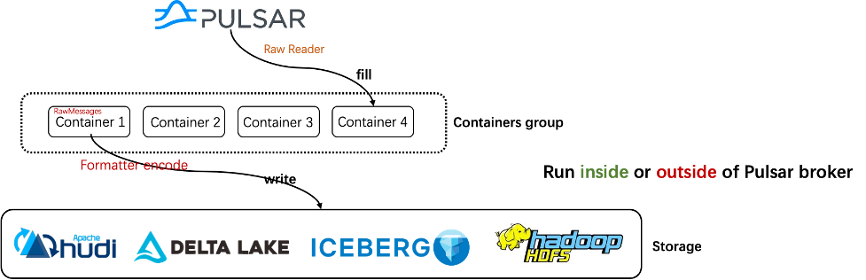
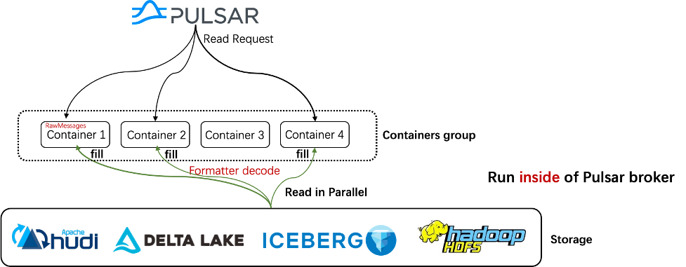
Future Tasks
3
Lakehouse Offloader

